Slide 1
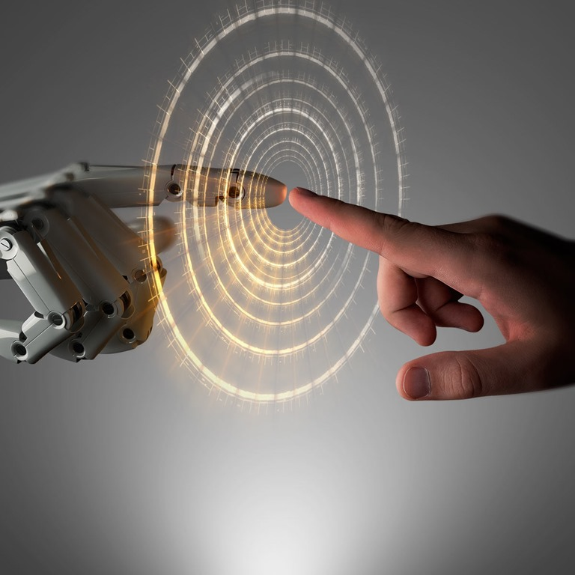
VR environments for amputee prosthetics training and rehabilitation
MYOwn Reality
Kamryx Davis, Jonathan Valderrama
Notes:
Picture from bing search on powerpoint under creative commons license

Slide 2
Topic
The purpose of this study is to explore different ways of mitigating phantom limb pain in amputees and providing alternate methods for prosthetics training and rehabilitation

Slide 3
Introduction
In the United States, it is expected that the amount of people living with limb loss will double in 45 years.
40% to 85% of amputees suffer from phantom limb pain (PLP) where there is a sensation of pain in an absent limb, there are not many treatments for mitigating PLP
To tackle this problem, we plan on using Virtual Reality with the combination of the MYO armband. With VR we want to create realistic environments to immerse the user and help reduce pain with different forms of distractions.
Notes:
In 2005, that amount was estimated at 1.6 million people and it will increase to 3.6 million in 2050.

Slide 4
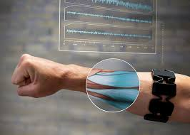
MYO ArmBand
A MYO armband is a gesture recognition arm band that can be used to wirelessly control technology
The MYO armband collects muscle signals that then get translated to hand and arm gestures
Notes:
Source of picture https://www.ireviews.com/review/myo-armband

Slide 5
Related Works
From several pieces of published literature, we have learned that amputation is becoming an increasingly larger problem worldwide and have learned possible treatments for the rehabilitation and training of amputees using virtual reality and myoelectric control.

Slide 6
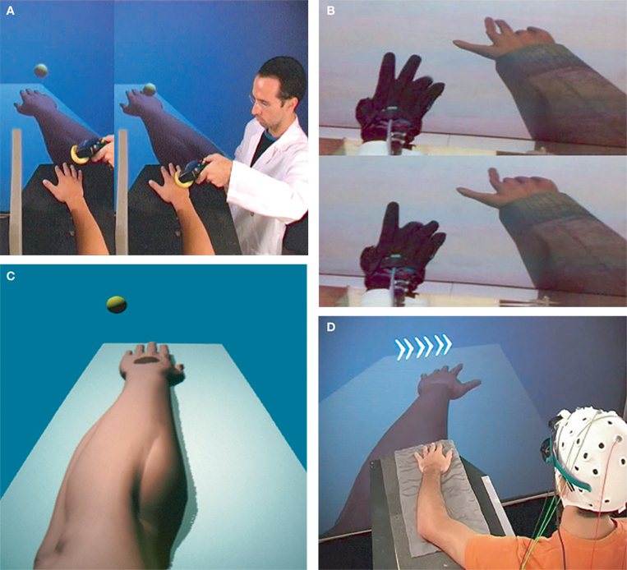
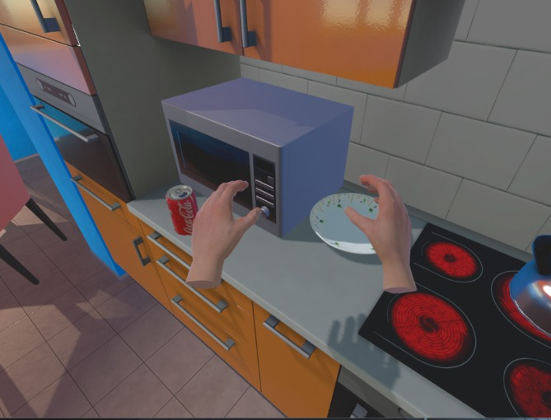
Related Works
Inducing Illusory Ownership of a Virtual Body
Slater et. al
Illusion of virtual body ownership focusing on how the brain distinguishes what is part of our body and what is not
Virtual reality adaptation of the rubber hand illusion, where a person claims “illusory ownership” of a rubber arm.
Immersive Virtual Reality Therapy with Myoelectric Control for Treatment-resistant Phantom Limb Pain: Case Report
Chau et. al
Immersive virtual reality therapy along with MYO band to help treat Phantom Limb Pain (PLP)
VR version of traditional mirror therapy which has the patient view their intact limb in a mirror to make it appear as their amputated limb
Notes:
Teacher Suggestions: Include How we are combining studies to solve our problem? The article by chau et al showed us an example of how we could combine VR with the MYO band to help with the rehabilitation of amputees, the article by chau et. al explained how we could fool the body to claim ownership of virtual body parts. From other studies we have read we learned things such as how we could modify the appearance of the arm for different effects and training techniques used with prosthetics.

Slide 7
Research Question(s)
Will variables such as gender and age affect the completion times of the Southampton Hand Assessment Procedure (SHAP) tests in the VR environment?
Will VR limb variables such as hand and arm appearance affect the completion times of the SHAP tests?
Will the VR environment combined with SHAP tests and the MYO armband affect the subjects’ pain levels?
Will the subjects' SHAP tests completion times change with multiple trials?
Notes:
Teacher suggestions: Show picture of shap test, myo band, picture of literature and 3 points author et al, more pictures

Slide 8
Research Methods
Using Unity3d to create a virtual environment where a user can run tests taken from Southampton Hand Assessment Procedure (SHAP) combined with MYO Band to detect gestures
For each SHAP Test we’ll collect completion times of each task, gender and age and compare those numbers with the represented virtual limb variables
Measuring pain before and after being inside VR environment with a Short-Form McGill Pain Questionnaire, Visual Analog Scale (VAS) and the Wong-Baker FACES pain scale, to see if there are any changes in pain

Slide 9
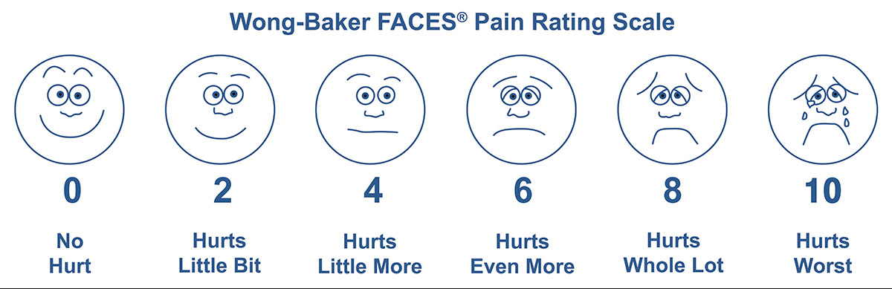
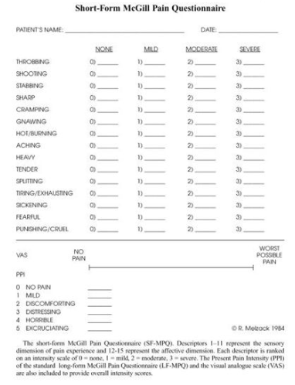
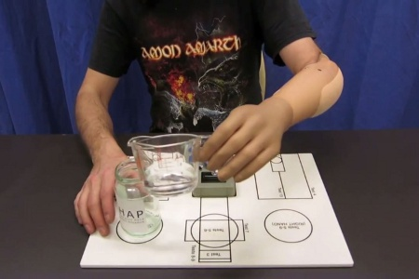
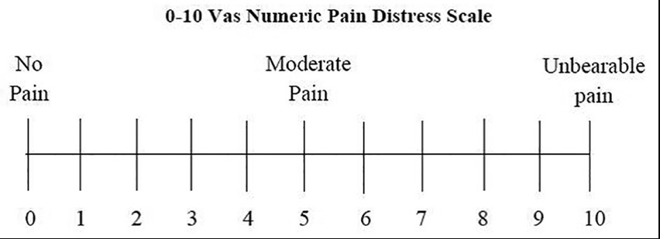
Research Methods
SHAP- a test to access hand function particularly in people in with prosthetics and limb impairments
Notes:
Teacher Suggestions: Put pictures of scales and questionaires
Shap picture source https://www.meddeviceonline.com/doc/bionic-reconstruction-enables-men-replace-nonfunctioning-hands-0001
Vas picture source https://www.researchgate.net/profile/Pradeep_Koppolu3/publication/295250172/figure/fig1/AS:333063214125059@1456419866974/Visual-analog-scale.png
Wong Baker http://wongbakerfaces.org/wp-content/uploads/2015/06/FACES_English_Blue1.jpg
McGill Pain questionnaire https://www.physio-pedia.com/Short-form_McGill_Pain_Questionnaire

Slide 10
Hypothesi(e)s
The VR environment combined with the Southampton Hand Assessment Procedure (SHAP) tests and the MYO armband will not increase pain in the test subjects.
Variables such as gender and age will affect the completion times of the SHAP tests in the VR environment.
VR limb variables such as hand and arm appearance will affect the completion times of the SHAP tests.
The subjects' SHAP tests completion times will decrease with multiple trials.

Slide 11
Preliminary Framework
Install Unity 3d
Install MYO Connect App
Setup scene in Unity
Add hand models and modify animations
Create scripts to manipulate hand with the MYO armband

Slide 12
Plan of attack / Rough deliverables
Create 2 rooms. Empty room as a control and a home environment.
Model SHAP tasks and objects.
Hand pick up and drop objects
Collect data from trials
Plot data
Create questionnaires

Slide 13
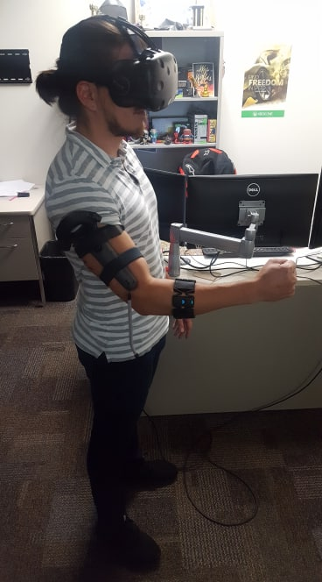
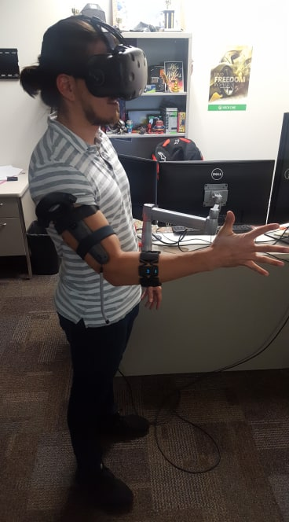
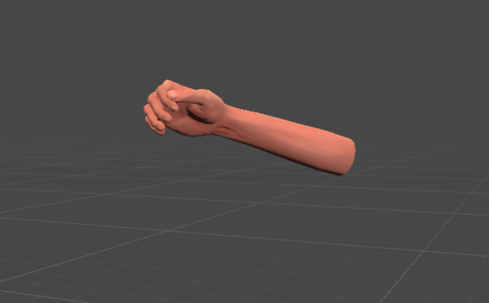
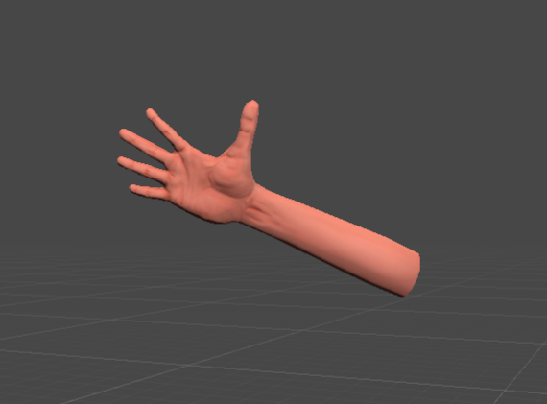
Preview

Slide 14
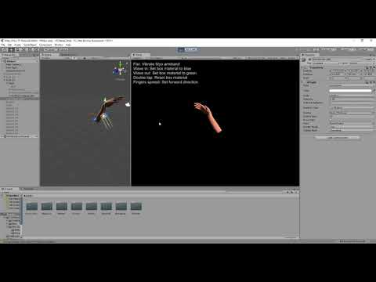
Video Demo

Slide 15
Gesture Animations with Myo Armband https://youtu.be/hZmsCc_fCp8

